Slide 1

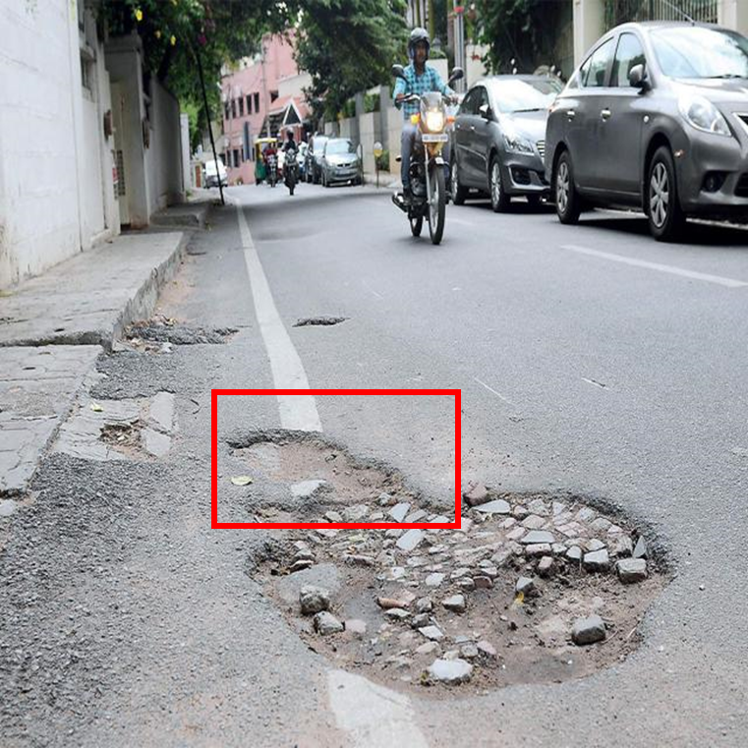
Axis-Aligned Bounding Box (AABB - txt file
class_id coordinates (x_center, y_center) (width) (height)
Oriented Bounding Box (OBB) - txt file
class_id coordinates (x_center, y_center) (width) (height) (Rotation angle (θ))

Slide 3
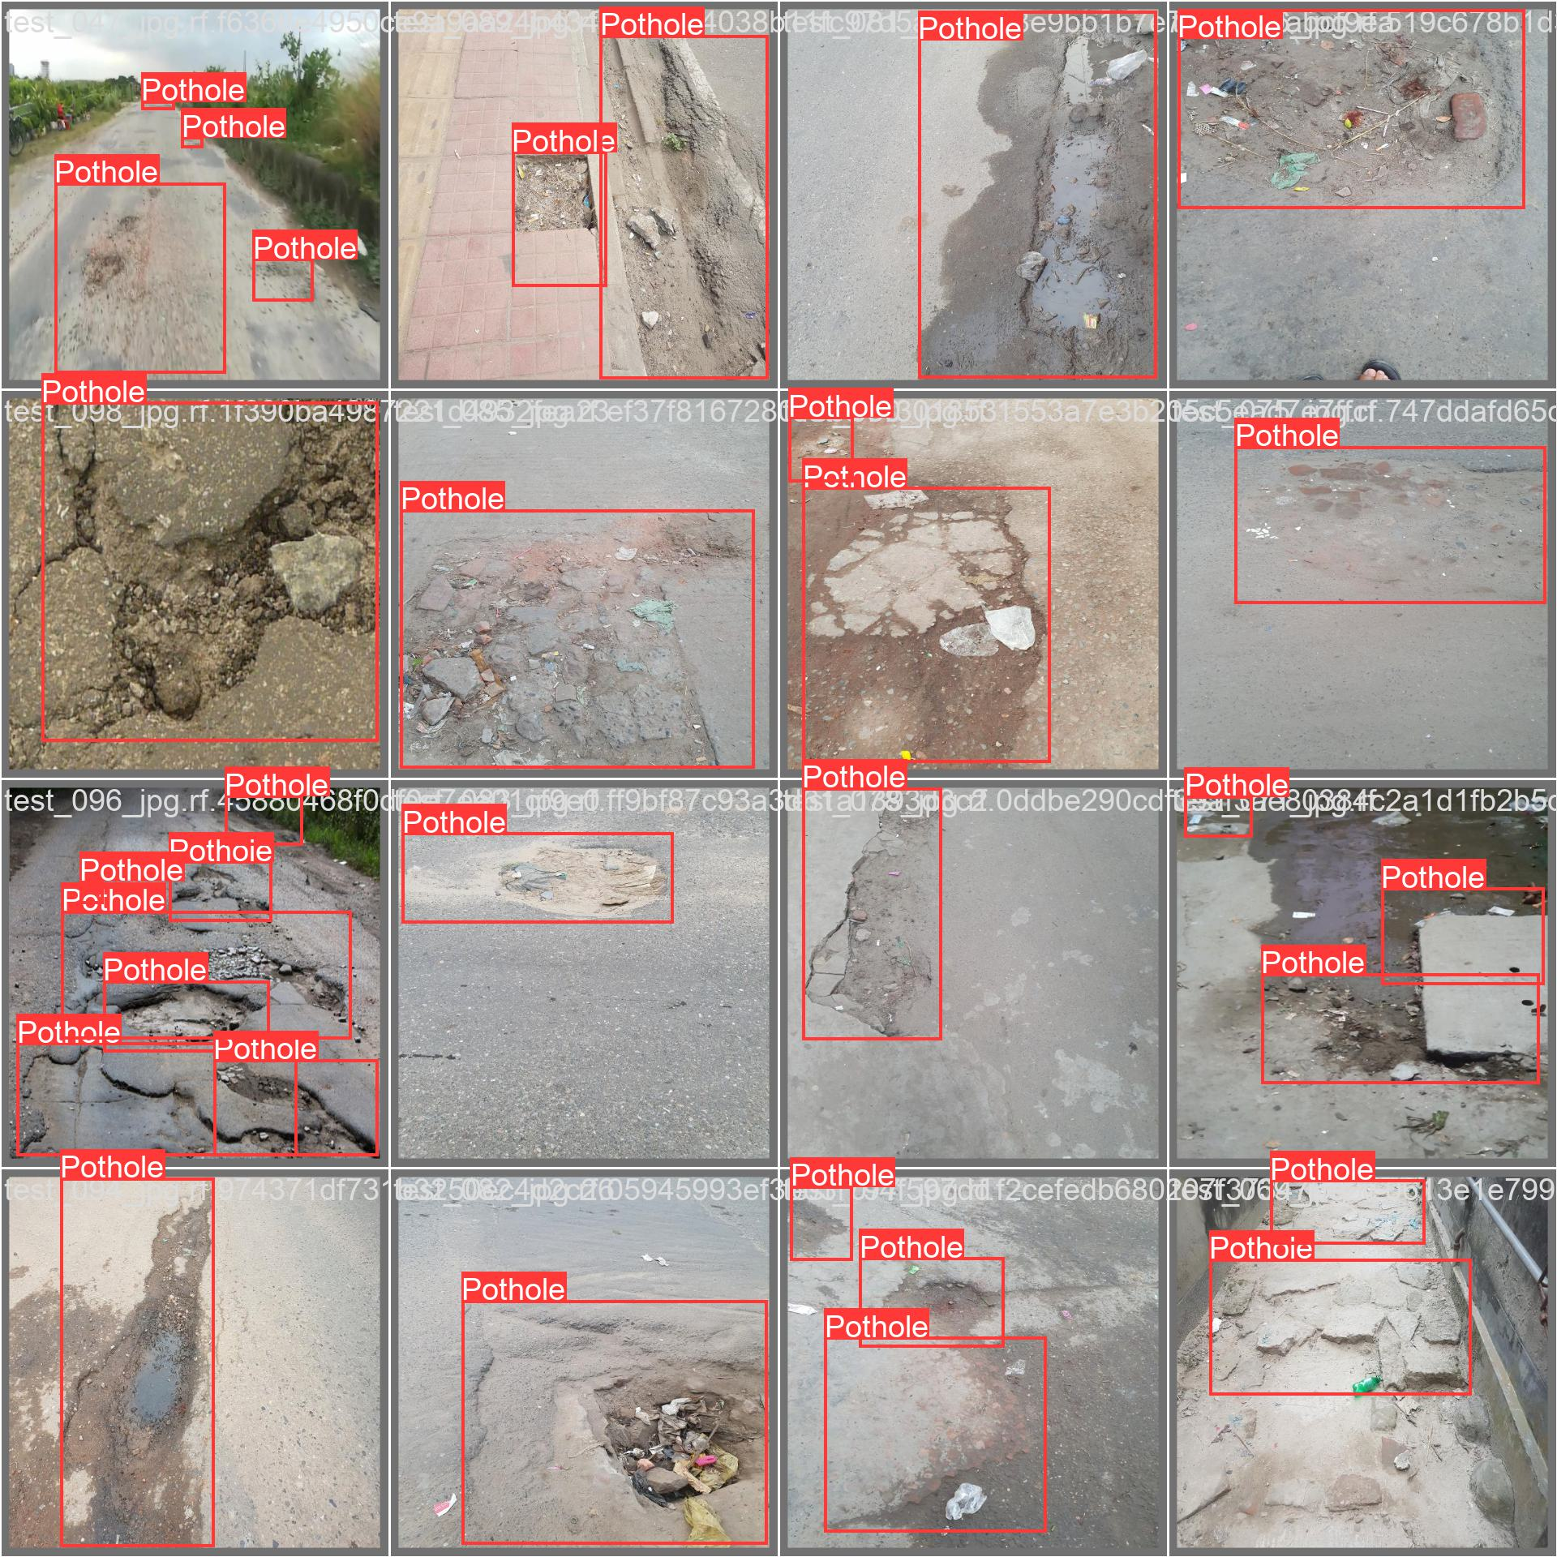

Slide 4

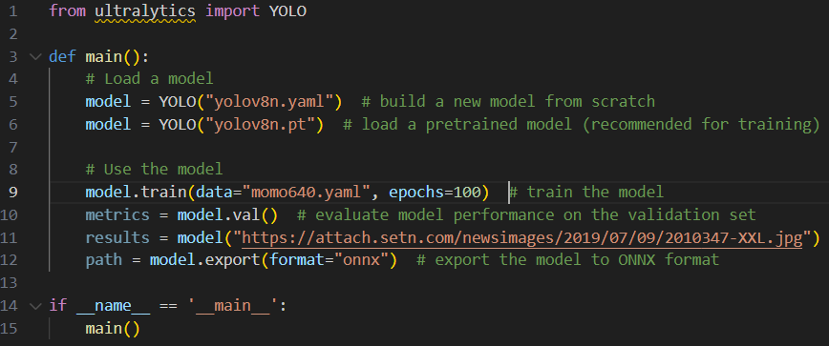
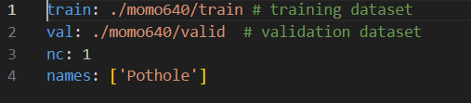

Slide 5
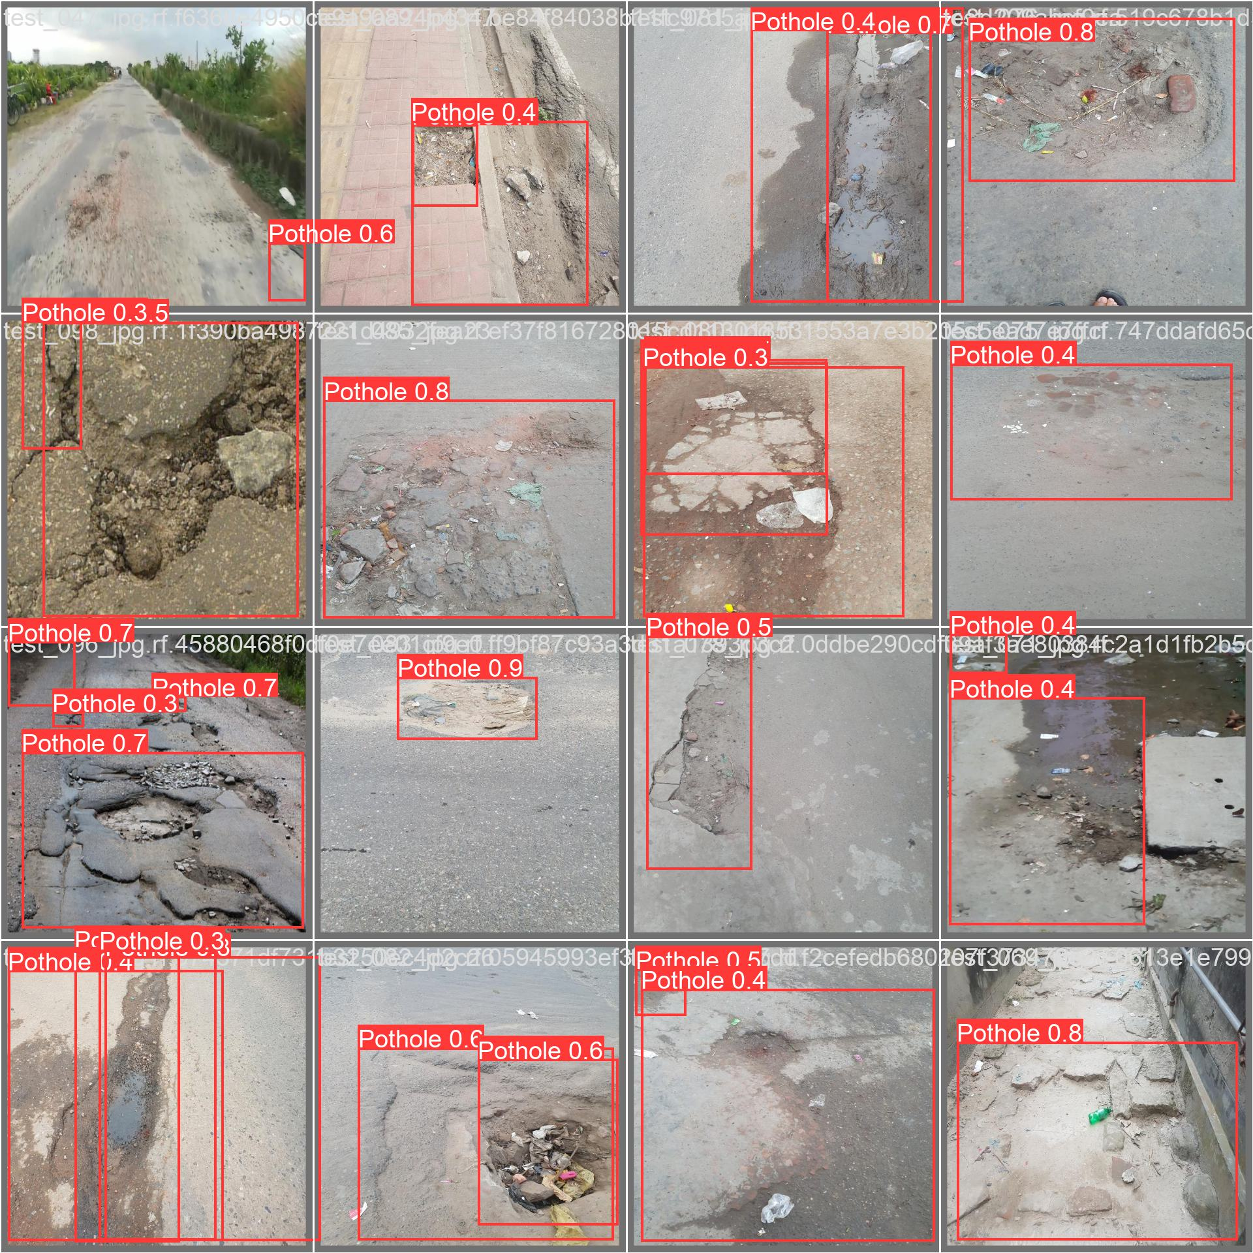

Slide 6
Multi Class
Inhouse training
Customized test program
YOLO v9 VS v8
Downlaod Ultrlytics, my code
Use more threshold to analyze efficientnet backbone

Slide 7
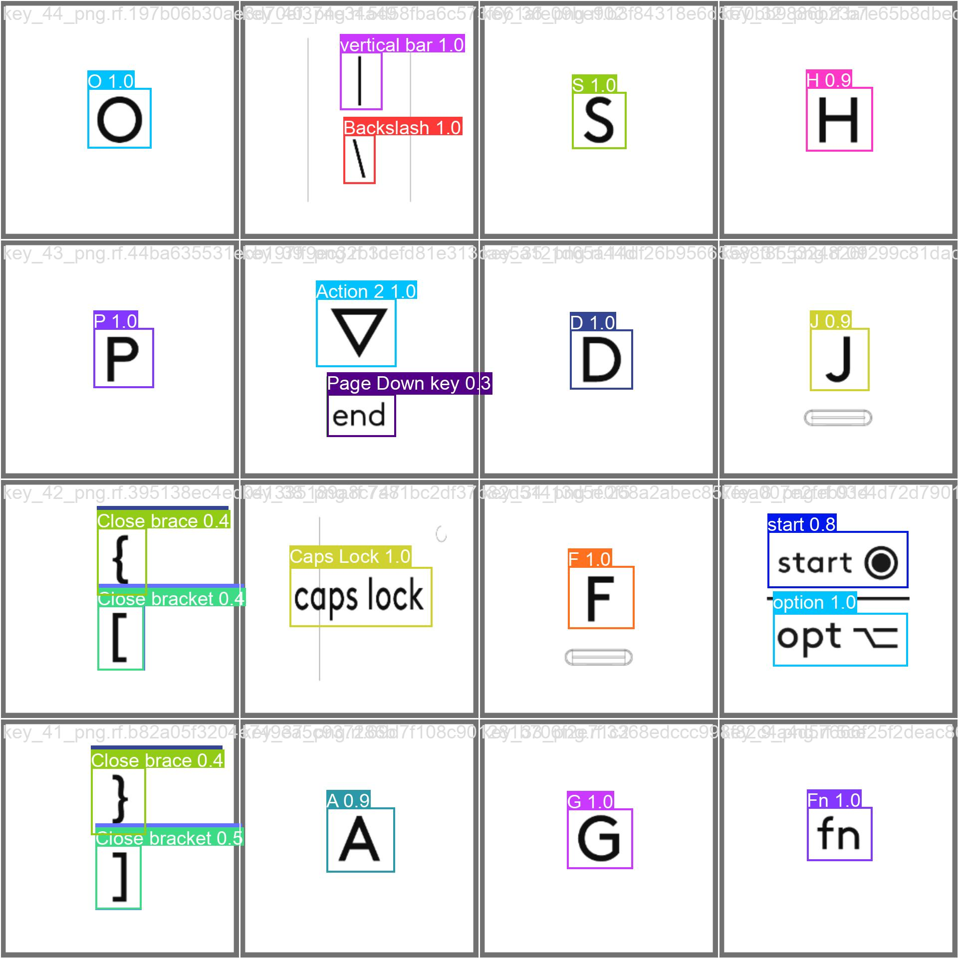
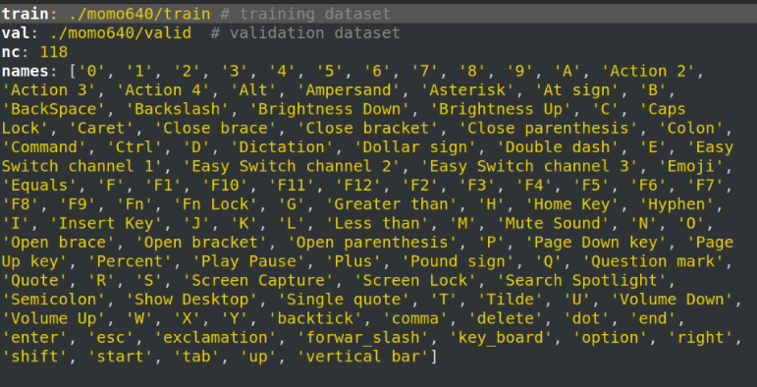

Slide 8
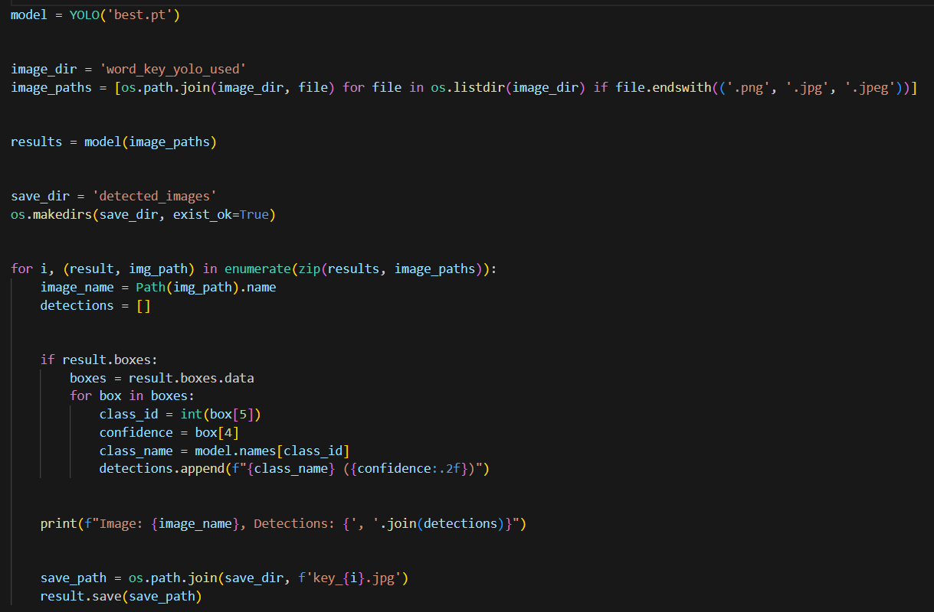

Slide 9
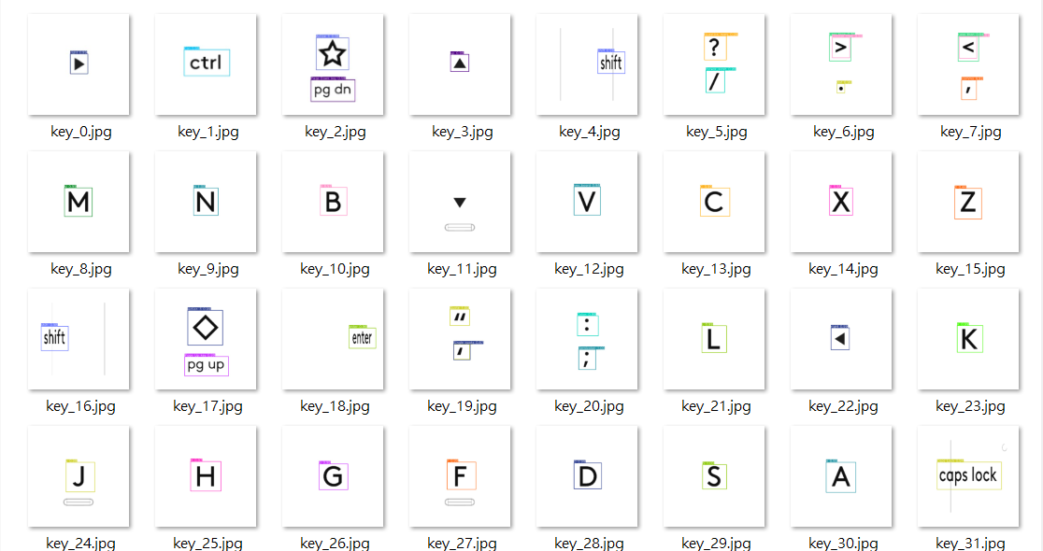

Slide 10
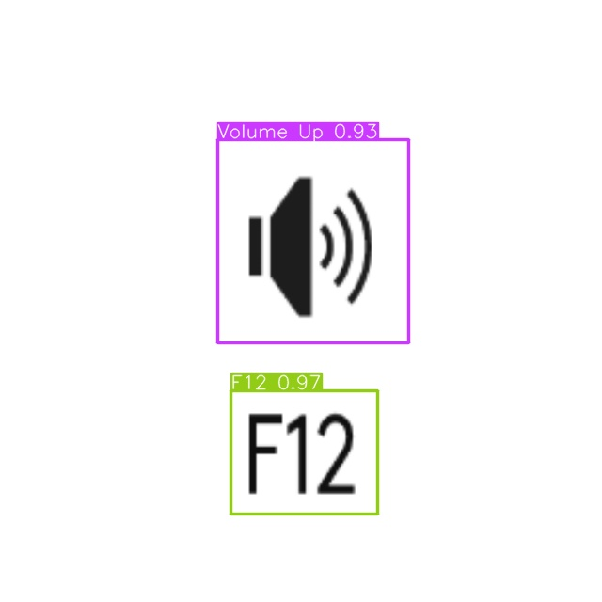
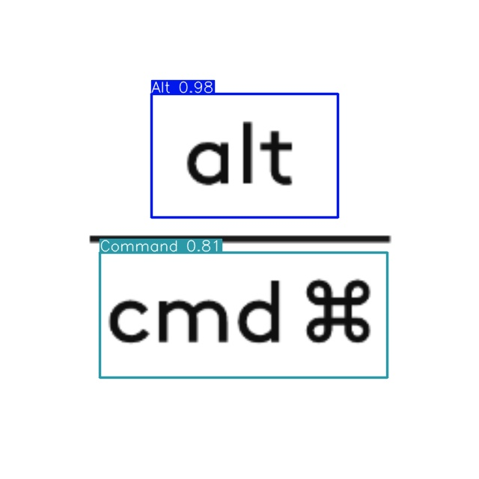
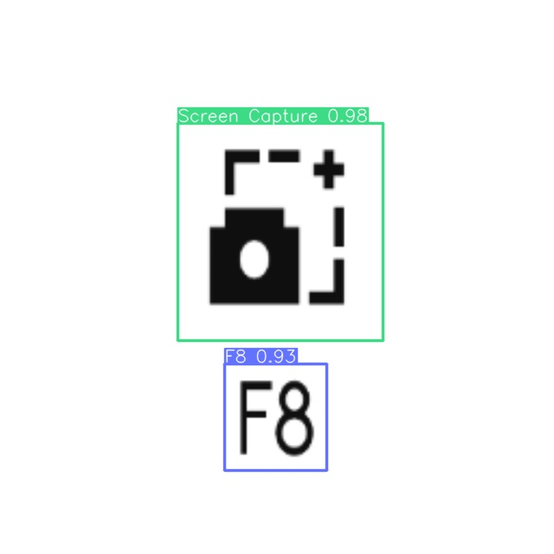
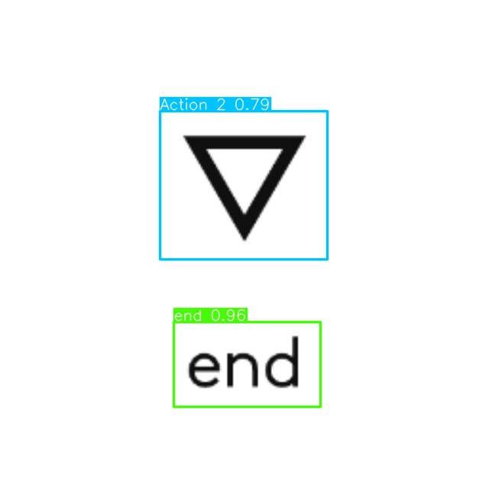

Slide 11
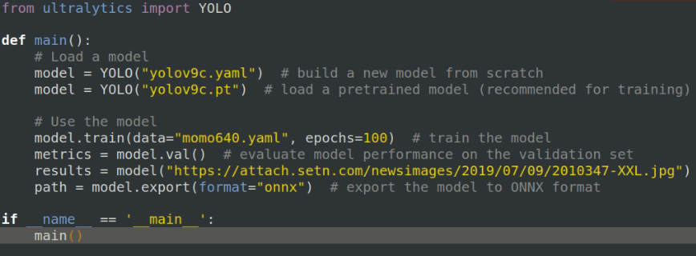
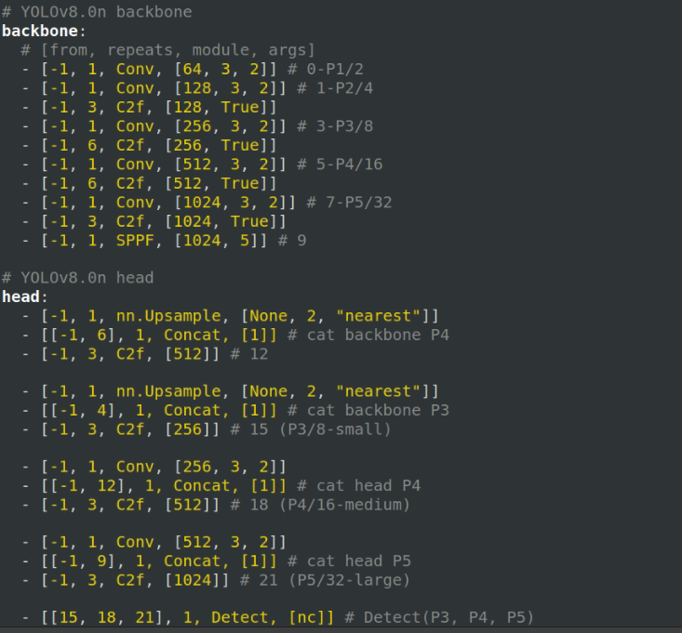
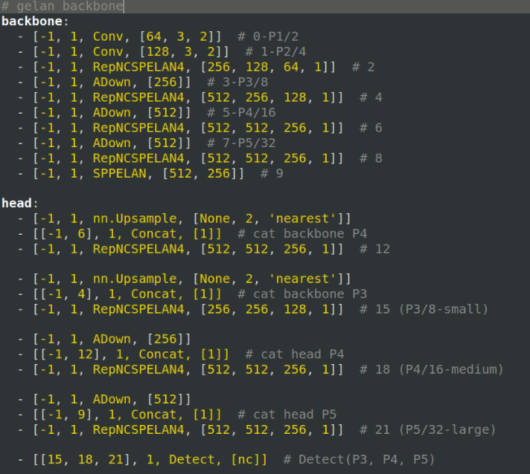
YOLO V8n
YOLO V9c

Slide 12
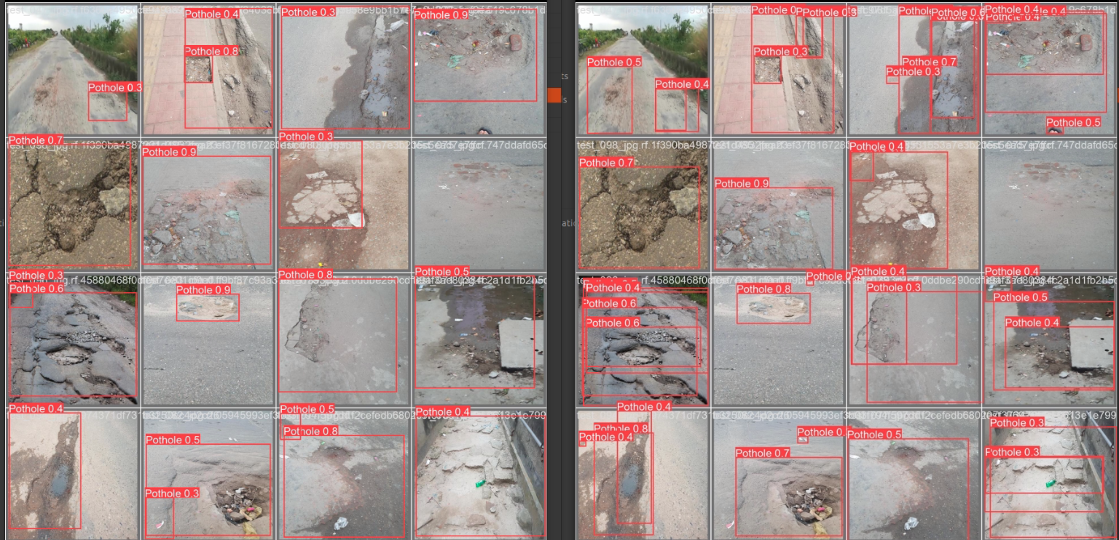
YOLO V8n
YOLO V9c

